Slide 1


Handlebars
Introduction

Slide 2
Agenda
What is Handlebars and why use it?
Setup and Getting Started
Html Escaping and Commenting in Handlebars
Helpers Built-in and Custom
Block Expressions
Partials
References

Slide 3
What is Handlebars
Handlebars.js is an extension to the Mustache templating language created by Chris Wanstrath. Handlebars.js and Mustache are both logicless templating languages that keep the view and the code separated like we all know they should be.
Handlebars is one of the most popular templating engines and builds on top of Mustache. Anything that was valid in a Mustache template is valid in a Handlebars template, so I won't cover those basics again. Handlebars add lots of helpers to Mustache.
Handlebars provides the power necessary to let you build semantic templates effectively with no frustration.

Slide 4
Why Handlebars
Handlebars is one of the most advanced (pre-compiling and the like), feature-rich, and popular of all the JavaScript templating engines, and it has the most active community.
Handlebars is a logic-less templating engine, which means there is little to no logic in your templates that are on the HTML page. The most important use of Handlebars, and any templating engine, is to keep your HTML pages simple and clean and decoupled from the logic-based JavaScript files, and Handlebars serves this purpose well.
Built on top of and compatible with the popular Mustache js another templating engine and therefor is largely compatible with Mustache templates.

Slide 5

Setup
There are 3 ways to use handlebars
Download handlebars from https://cdnjs.cloudflare.com/ajax/libs/handlebars.js/4.0.5/handlebars.min.js
If u need to setup using NPM use It can then be loaded using
For setup using bower use the bower command

Slide 6
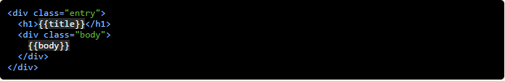
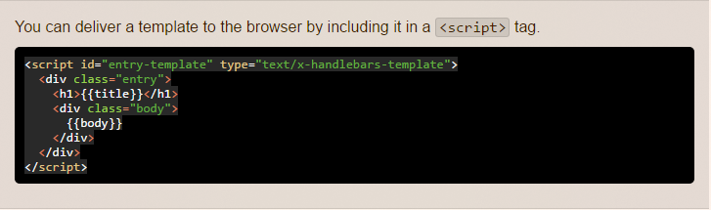
Getting Started Handlebars templates look like regular HTML, with embedded handlebars expressions. A handlebars expression is a {{, some contents, followed by a }} Compile a template in JavaScript by using Handlebars.compile

Slide 7
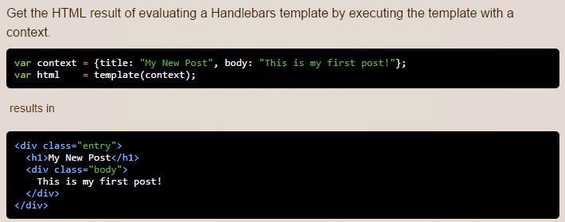

Slide 8
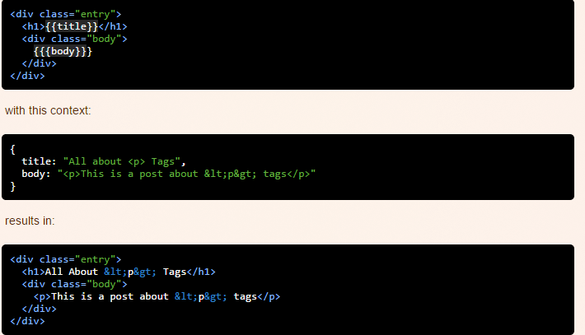
HTML Escaping
Handlebars HTML-escapes values returned by a {{expression}}. If you don't want Handlebars to escape a value, use the "triple-stash", {{{.

Slide 9
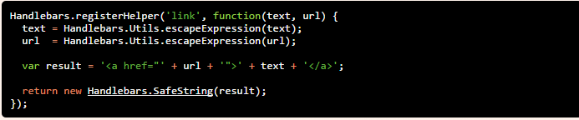
Handlebars will not escape a Handlebars.SafeString.
If you write a helper that generates its own HTML, you will usually want
to return a new Handlebars.SafeString(result).
In such a circumstance, you will want to manually escape parameters.
This will escape the passed in parameters, but mark the response as safe,
so Handlebars will not try to escape it even if the "triple-stash" is not used.

Slide 10
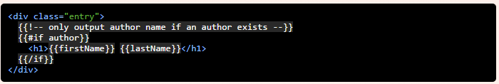

Template comments with {{!-- --}} or {{! }}.
You can use comments in your handlebars code just as you would in your code. Since there is generally some level of logic, this is a good practice.
The comments will not be in the resulting output. If you'd like the comments to show up. Just use html comments, and they will be output.
Any comments that must contain }} or other handlebars tokens should use the {{!-- --}} syntax.

Slide 11
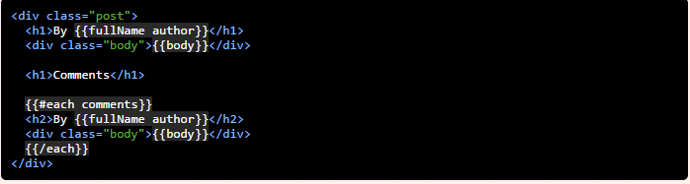
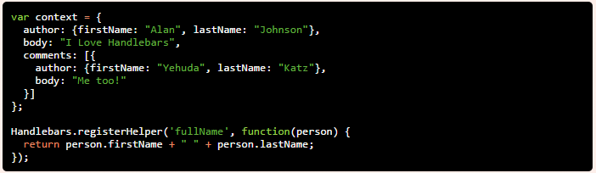
Helpers
Handlebars helpers can be accessed from any context in a template.
You can register a helper with the Handlebars.registerHelper method.
This is our context

Slide 12
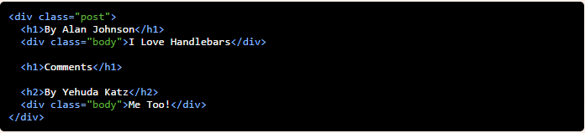
This is our Result

Slide 13
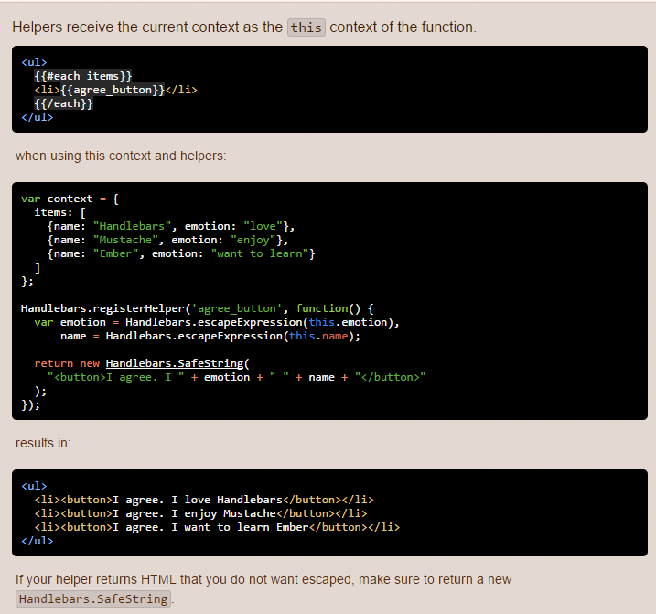

Slide 14
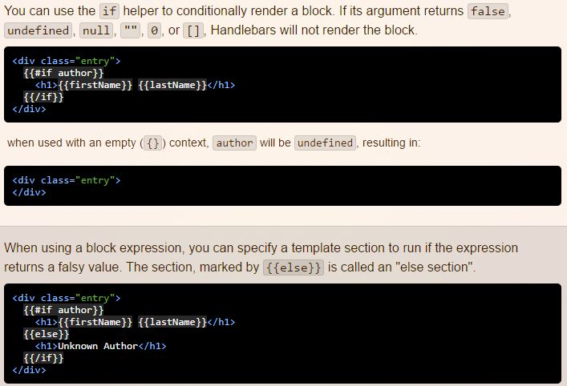
Built-In Helpers (if, unless, each, with)
The if block helper

Slide 15
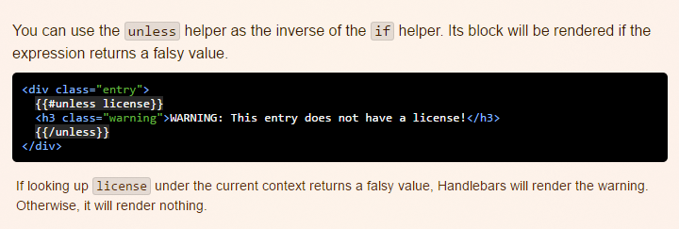
Unless block helper

Slide 16
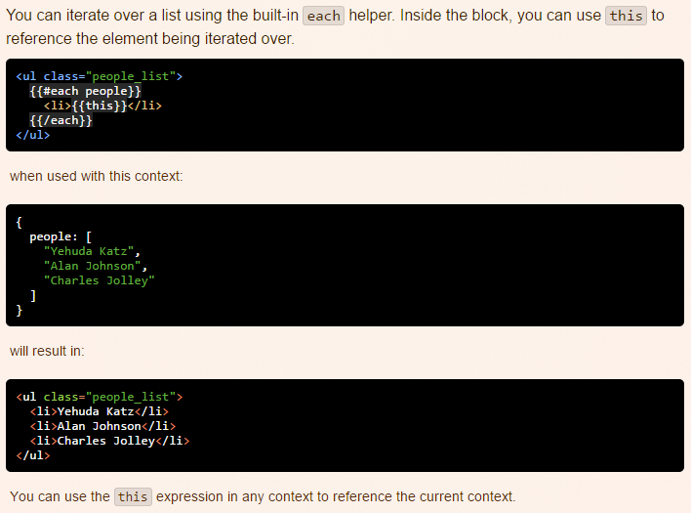
Each

Slide 17
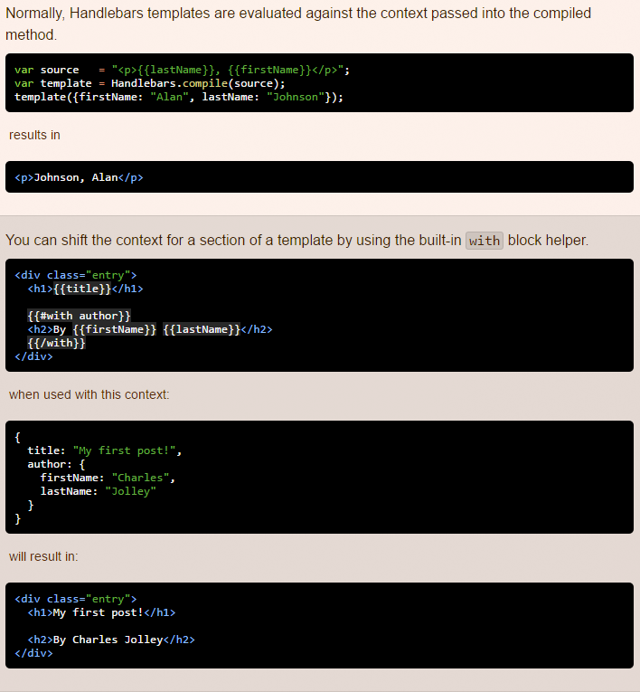
The with Block Helper

Slide 18
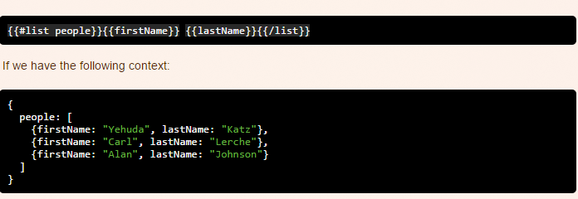
Block Expressions
Block expressions allow you to define helpers that will invoke a section of your template with a different context than the current. These block helpers are identified by a # preceeding the helper name and require a matching closing mustache, /, of the same name.

Slide 19
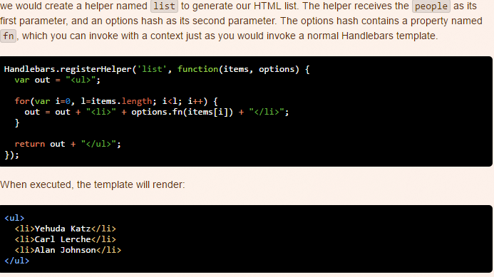

Slide 20
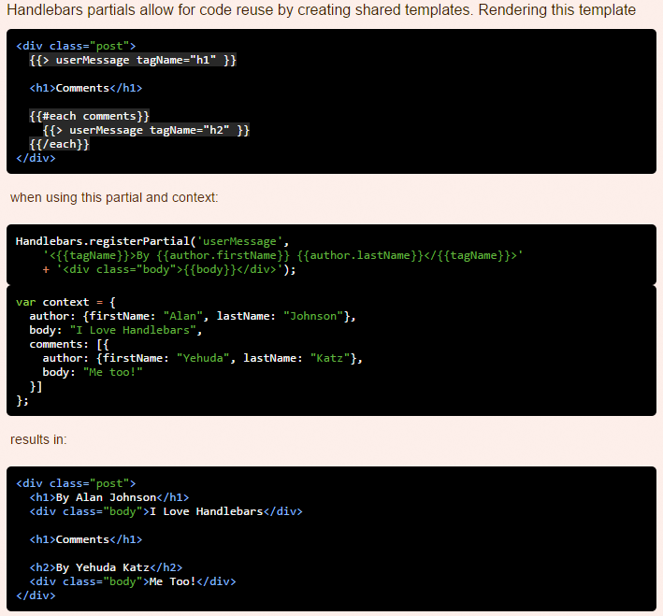
Partials

Slide 21
References
http://handlebarsjs.com/
https://github.com/wycats/handlebars.js#readme
http://tryhandlebarsjs.com/
http://handlebarsjs.com/builtin_helpers.html
http://handlebarsjs.com/partials.html
http://handlebarsjs.com/reference.html
http://tutorialzine.com/2015/01/learn-handlebars-in-10-minutes/
http://javascriptissexy.com/handlebars-js-tutorial-learn-everything-about-handlebars-js-javascript-templating/

Slide 22
Thank You

